Slide 1
Multivariate Statistical Analysis
Singular Value Decomposition (SVD)
Principal Componet Analysis (PCA)

Slide 2
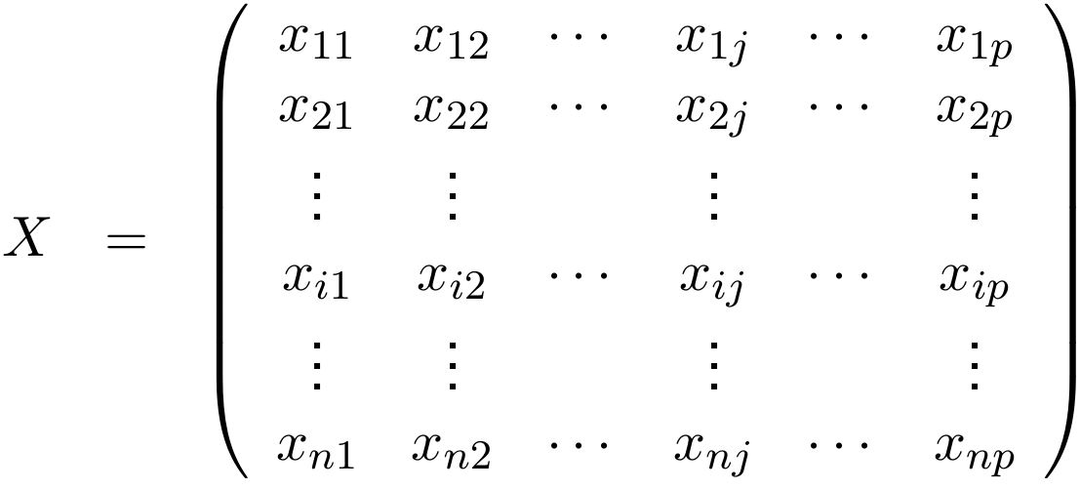






Preliminaries
Consider the data set
where
the row
represents the th instance,
the column
represents the th feature,
for
and

Slide 3
Singular Value Decomposition (SVD)
Key idea
The decomposition into singular values of a data set allows to rewrite the original matrix as a linear combination of matrices where the coefficients are the singular values. These singular values indicate the contribution that each matrix has to the data set. In this way, by eliminating the matrices that contribute little to the database, an approximation to the data set with less resources is obtained.

Slide 4
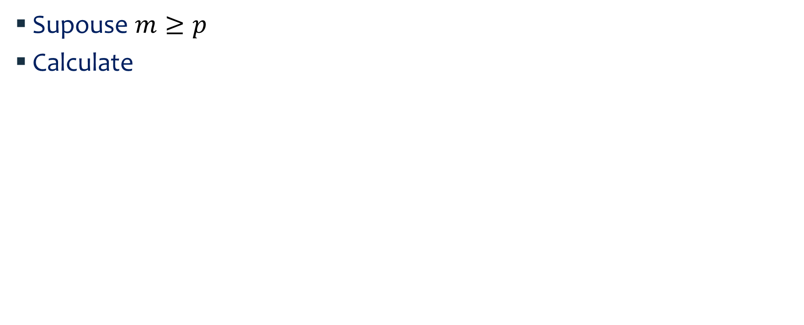
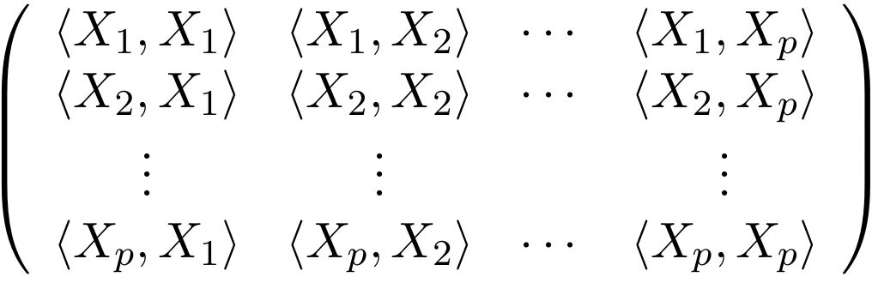

SVD: steps

Slide 5




SVD: steps
Obtain the set of eigenvalues and eigenvectors of
Since is a symmetric matrix, by the Principal Axes Theorem it has an orthonormal set of eigenvectors ,
and since it is a positive definite matrix, its eigenvectors corresponding to the positive and ordered eigenvalues are
, with
Calculate the singular values of
Singular values not null:
Singular values null:

Slide 6
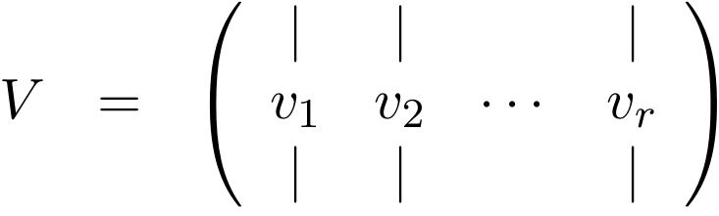
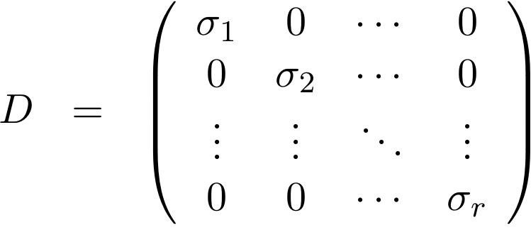
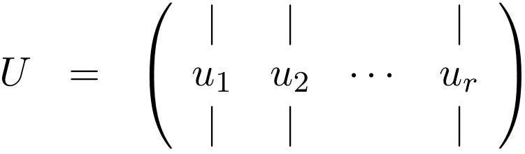

SVD: steps
Define:
Orthonormal matrix
Diagonal matrix
Orthogonal matrix
where

Slide 7
SVD: steps
Then, the data set can be decompose as

Slide 8



SVD: Meaning
Each singular value indicates the contribution that has to the data set, .
Ignoring the singular values with a low contribution, a good approximation represented into a minor subspace can be obtained.

Slide 9
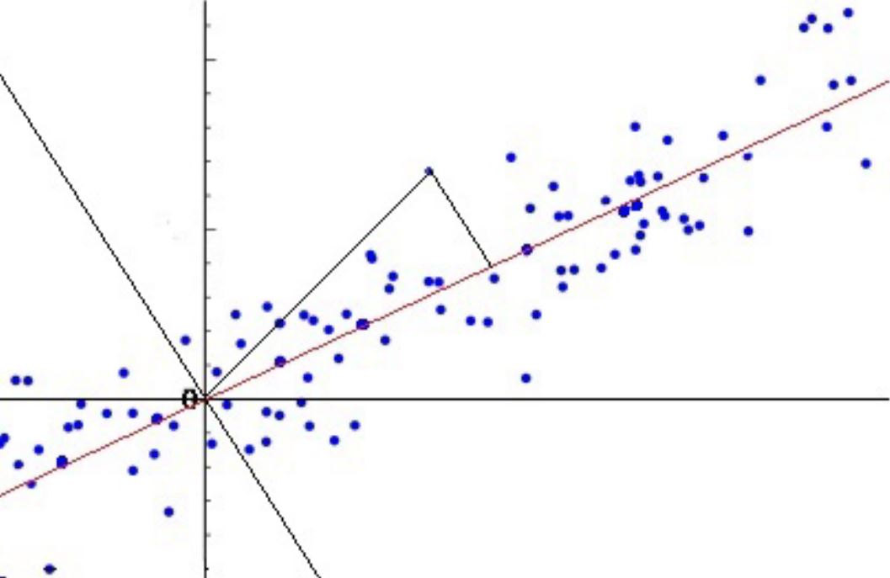
Principal Component Analysis (PCA)
Key idea
PCA uses an orthonormal linear transformation to represent the data set following the principle of least squares.
It takes the standardized database to a new ordered coordinate system that converts the set of characteristics, possibly correlated, into a set of variables without linear correlation called principal components.

Slide 10


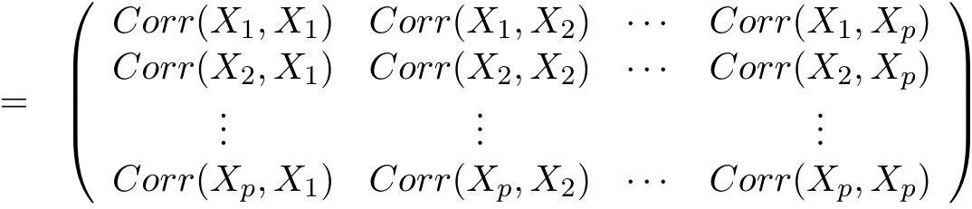

PCA: steps
Let the matrix be standarized, i.e. each ,
Has mean zero and variance equal one
Calculate its correlation matrix
where
, for all ,

Slide 11

PCA: steps
Obtain the set of eigenvalues and eigenvectors of
Since is a symmetric matrix, by the Principal Axes Theorem it has an orthonormal set of eigenvectors ,
and since it is a positive definite matrix, its eigenvectors corresponding to the positive and ordered eigenvalues .

Slide 12
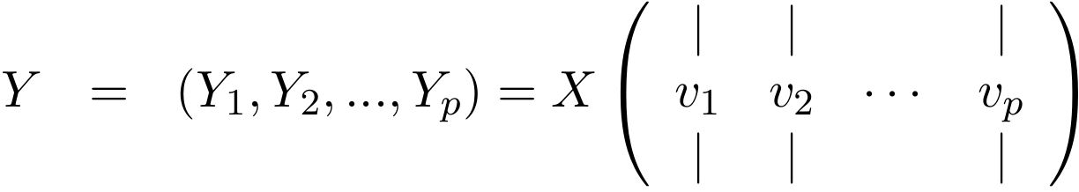


PCA: steps
Then, the Principal Component Matrix is
where is the first principal component,
is the second principal component, and so on.

Slide 13




PCA: Meaning
The Principal Component Matrix
represents the standarized data set into a new ordered coordinate system
where the new features are variables not correlated and ortogonal, i.e.
and ,
and keeps the least-squares property of finding the subspace with the minimum distance to the database.

Slide 14





PCA: Meaning
Each principal component ,
represents the projection of the original data set on the th coordinate given by the eigenvector corresponding to , the th eigenvalue,
keeps as much as possible information from the original database,
and the amount of information that keeps is given by its variance, where

Slide 15
PCA: Meaning
The property that let measure the amount of information throughout the variance of each principal component,
let:
to extrac the features which don’t aport a lot of information (the smallest variances), reducing dimensionality.
to identify and relatethe features which could be measuring the same principle governing the behavior of the data set.

Slide 16
Elementary linear algebra with applications
Nicholson, W. Keith, PSW Publishing Company, 1986
Numerical analysis: a mathemarical introduction
Schatzman, M., Oxford Universitiy Press, 2002
References

